Slide 1
Post Liver Transplant Infectious Complications
Mohammad Almeqdadi, MD
Transplant Hepatology Fellow, PGY-7

Slide 2
Outline
Epidemiology
General Principles
Risk Factors
Prophylaxis
Post-transplant infections

Slide 3
Epidemiology
Despite advances in liver transplantation, infectious complications remain a major problem.
Up to two-thirds of liver transplant patients have at least one episode of infection, with rates of 1 to 2.5 episodes per patient.
Infection accounted for 42% of deaths within a year of liver transplant in one study.
  Clin Infect Dis. 2020 Oct 23;71(7):e159-e169
Infection was the most frequent cause of mortality from 30 to 180 days post-transplant in a large analysis of liver transplants.
  Clin Infect Dis. 1995 Nov;21(5):1077-89

Slide 4
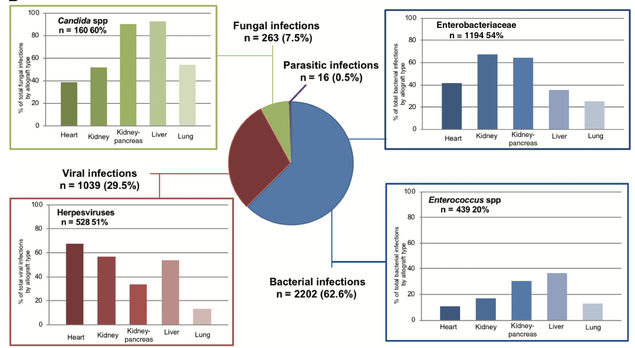
Types of infections
Clin Infect Dis. 2020 Oct 23;71(7):e159-e169

Slide 5
Overview of Transplant Immunology

Slide 6
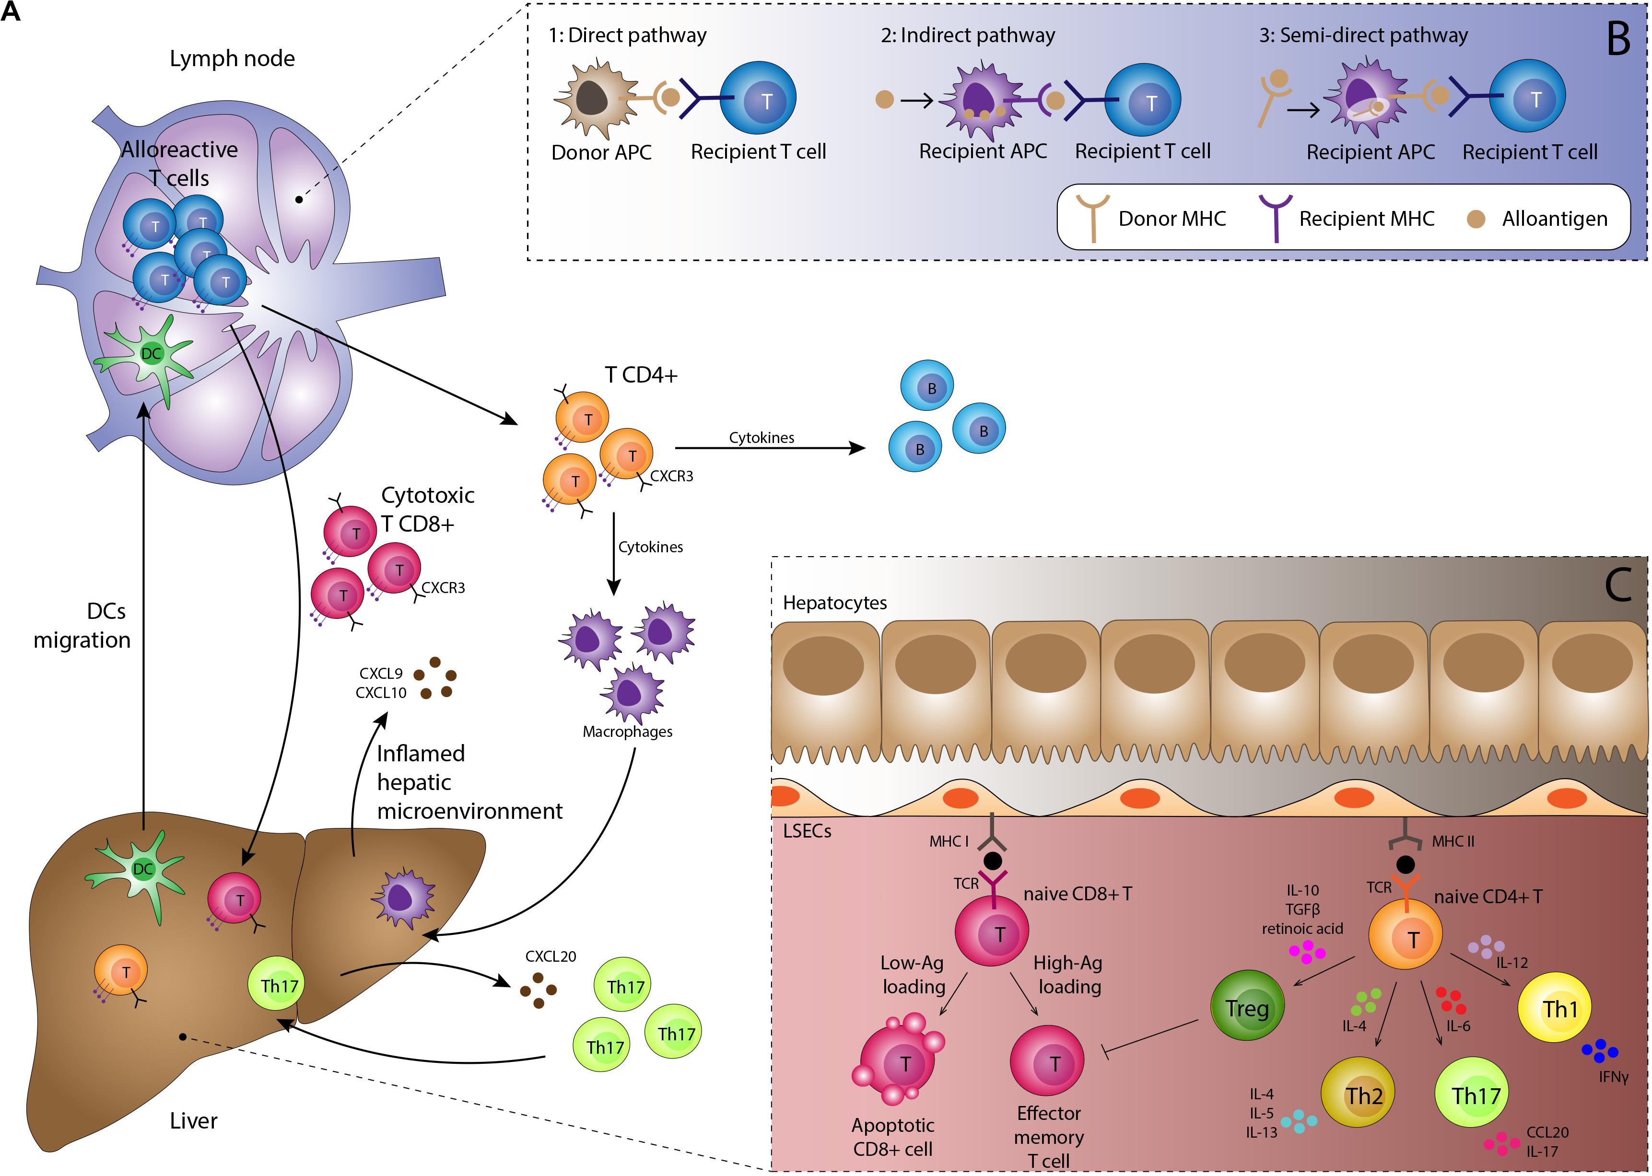
Front Immunol. 2020 Sep 2;11:2155

Slide 7
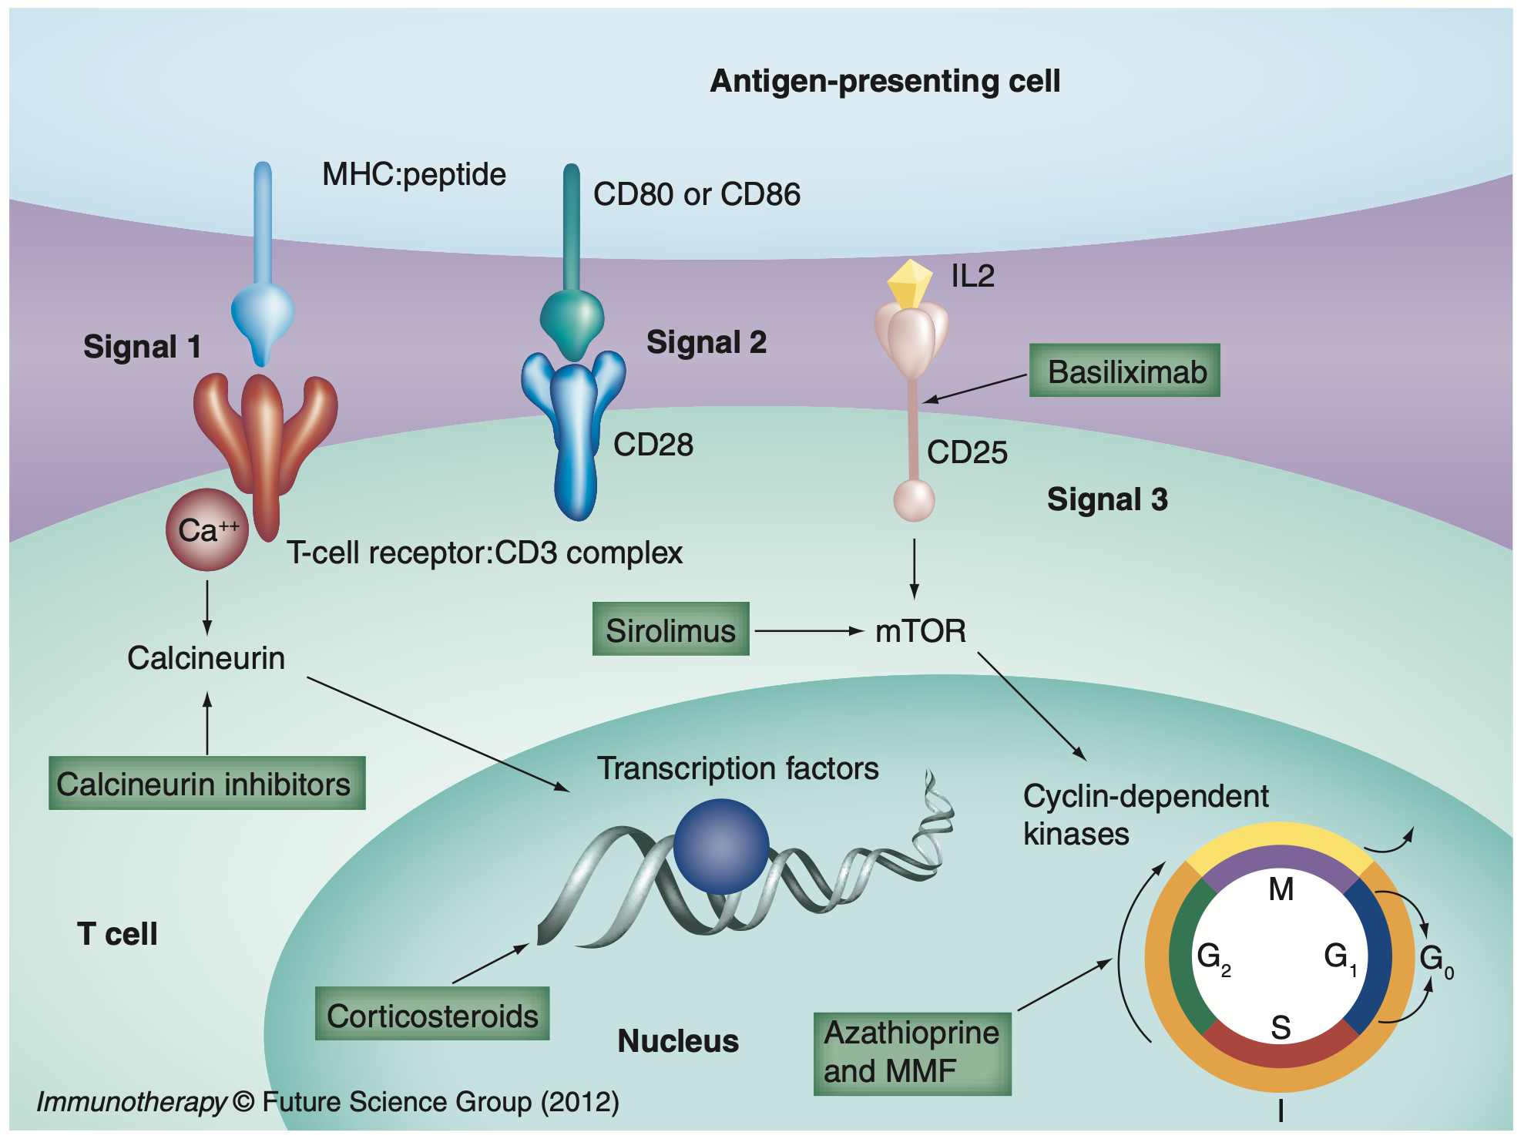
Immunotherapy 2012 4(8), 793–805.

Slide 8
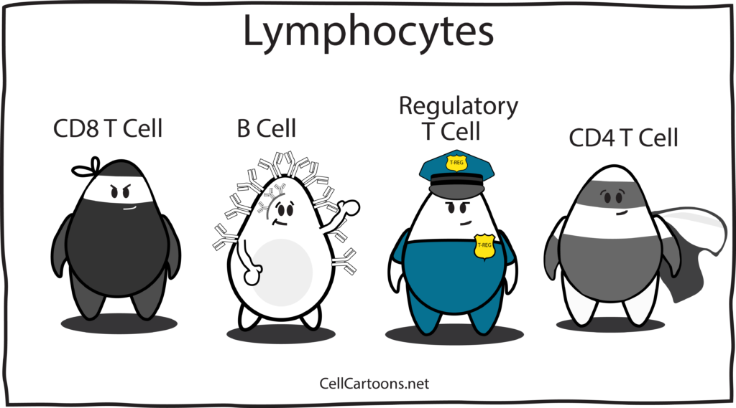
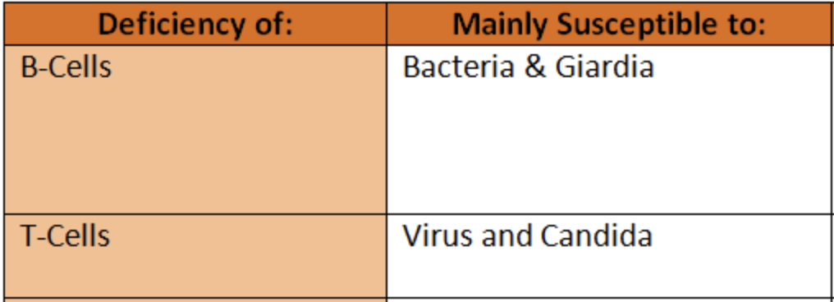

Slide 9
General Principles
Post liver transplant infections

Slide 10
General Principles
Immunosuppressed patient = less signs of infection
  Infections may be more severe compared to an immunocompetent host
Rejection may mimic infection!
There are lots of pathogens, but timing since transplant is everything
Beware of antimicrobial interactions with immunosuppression
  (i.e., fluconazole + tacro)
Net state of immunosuppression principle

Slide 11
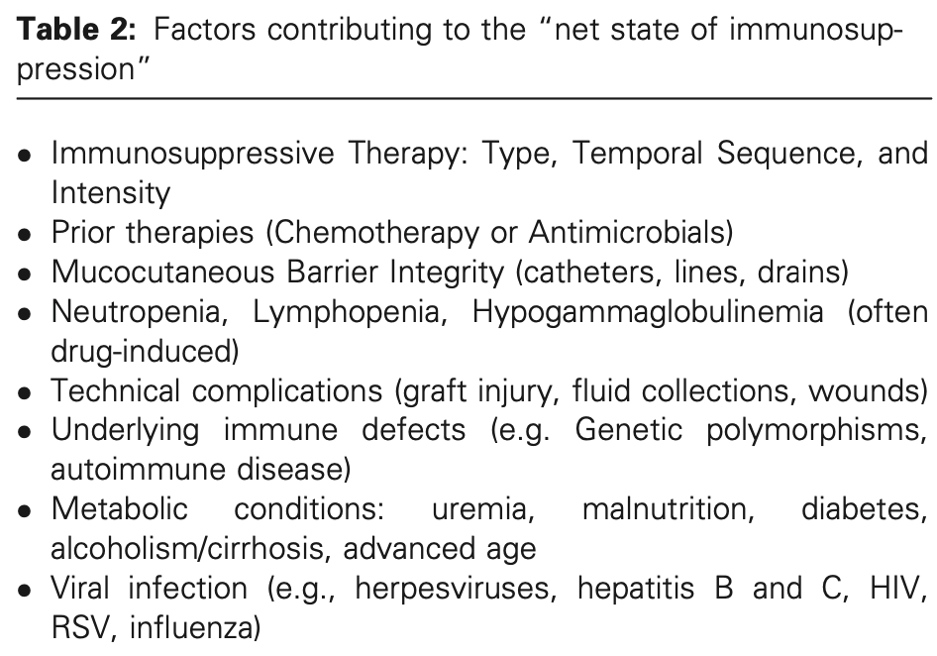
Net State of Immunosuppression
Am J Transplant. 2017 Apr;17(4):856-879

Slide 12
Risk Factors

Slide 13
Risk Factors
Latent infection in donor or recipient
Active infection in the donor
Pretransplant colonization with certain organisms
Surgical approach and surgical complications

Slide 14
Latent Infections in Donor or Recipient
Latent or unrecognized infections in transplant donors or recipients are a significant risk factor for morbidity after immunosuppressive therapy.
Transplant donors and recipients are routinely screened for infections such as CMV (+other HHVs), TB, HBV, HCV, Syphilis, and HIV.
Reactivation of latent infections after immunosuppressive therapy can cause significant morbidity in transplant recipients.

Slide 15
Active infection in the donor
Infection in the donor that is active at the time of organ procurement may also be transferred to the recipient
Donor blood stream infections (i.e. bacteremia) may cause anastomotic site infections (vessels, bile ducts, etc.)
Infections that may be accelerated by immunosuppression
  West Nile virus
  Lymphocytic choriomeningitis virus
  Rabies
  Leishmaniasis
  Chagas disease (trypanosomiasis)

Slide 16
Question
A patient who is a 60-year-old man with history of NASH cirrhosis with ascites, varices, and encephalopathy, MELD-Na of 27, underwent a deceased-donor liver transplant.
The donor was a 45-year-old man who had septic shock with MRSA bacteremia and endocarditis, with positive MRSA blood cultures at the time of death/procurement.
Would you start antibiotic prophylaxis for the recipient?
How long would you continue antibiotics for?

Slide 17
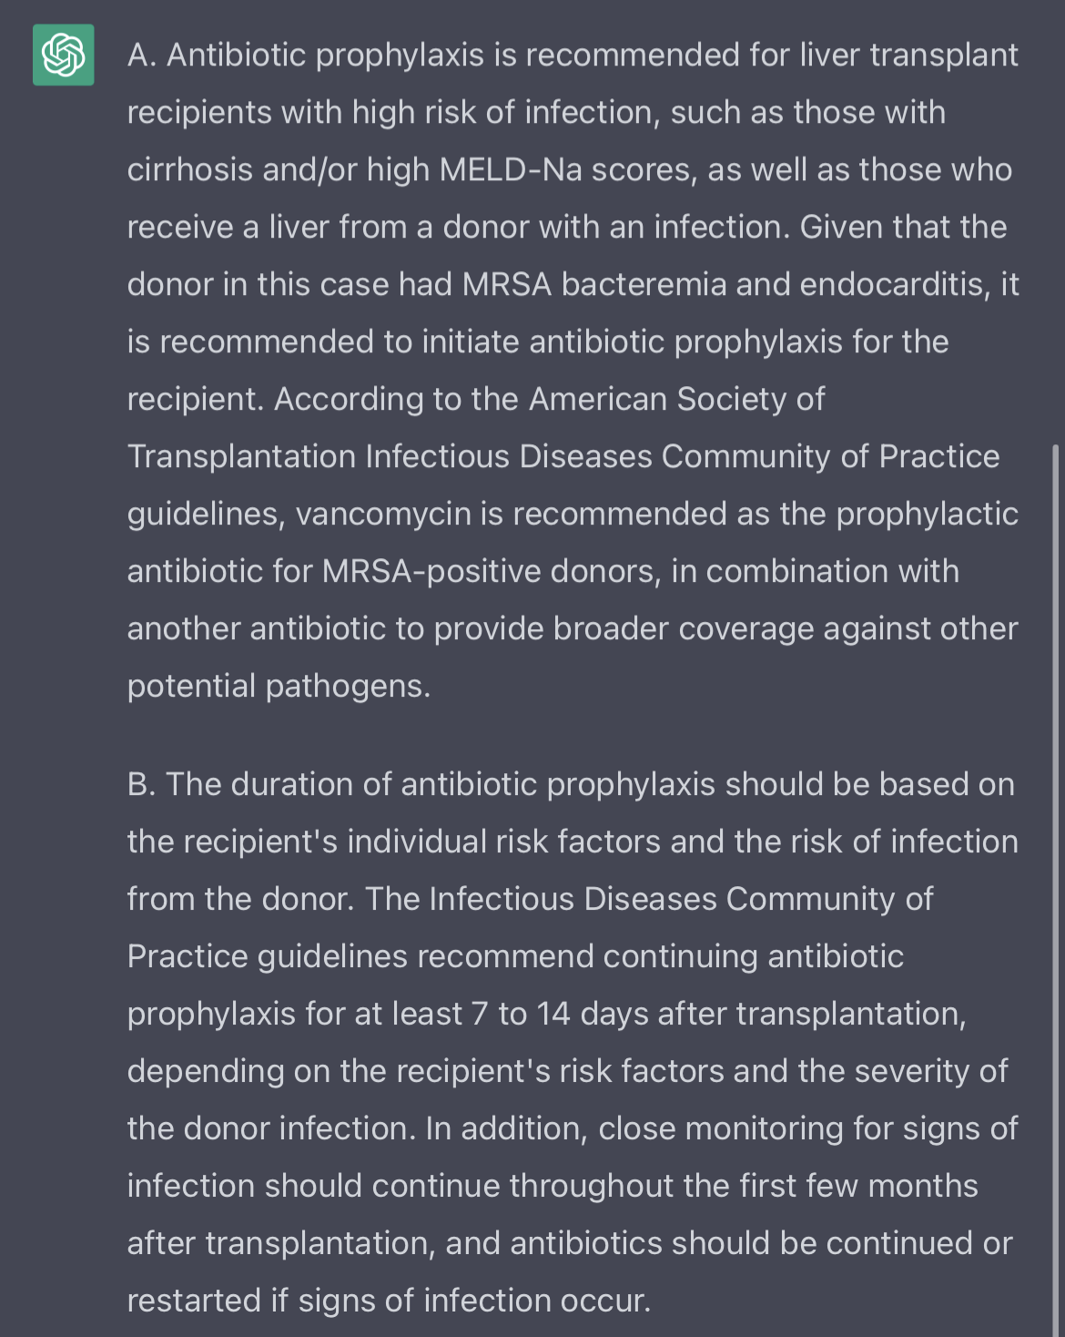
AI-Assisted Decision Making (ChatGPT)

Slide 18
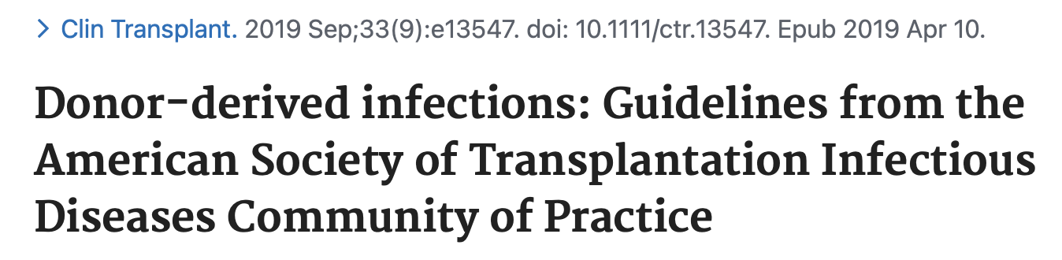
Donors with documented bacteremia should should be treated with targeted antimicrobial treatment for at least 24-48 hours, optimally with some degree of clinical response.
The recipient should receive 7- to 14-day course of antibiotics targeted to the organism isolated from the donor. (Strong, Moderate)

Slide 19
Pretransplant colonization with certain organisms
Pre-transplant colonization with organisms such as MRSA, multidrug-resistant Enterobacteriaceae, or VRE can increase post-transplant infection risk and mortality.
Colonization by these organisms is not a contraindication to transplantation
Solid organ transplant recipients have an increased prevalence of multidrug-resistant gram-negative bacilli (eg, extended-spectrum beta-lactamase-producing Enterobacteriaceae and carbapenem-resistant Enterobacteriaceae)

Slide 20
Surgical approach and surgical complications
Various risk factors for infection after liver transplantation have been reported, many related to surgical complications of the transplant operation.
Roux-en-Y biliary anastomosis has been associated with increased risk of bacterial infections compared to choledochocholedochostomy.
Multiple abdominal surgeries and CMV infection in the postoperative period have also been identified as risk factors for bacterial infections.
Similar risk factors have been identified for post-transplant fungal infections.

Slide 21
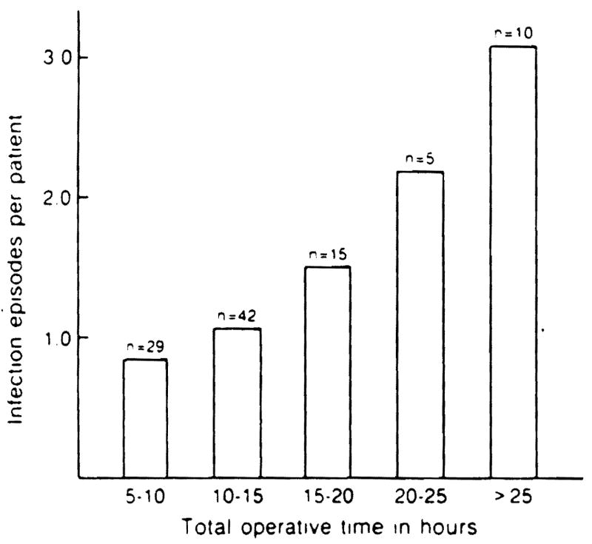
Infections after liver transplantation. An analysis of 101 consecutive cases
Medicine (Baltimore). 1988 Mar;67(2):132-43

Slide 22
Other Factors
Graft dysfunction and pre-existing critical illness increase the risk of post-transplant infection.
CMV infection increases the risk of other infections
Patients who develop rejection or have poor graft function after transplant are at increased risk of infection due to receiving a more aggressive immunosuppressive regimen.

Slide 23
Infection Prophylaxis

Slide 24
Infection Prophylaxis
Pretransplant vaccines
Antibacterial prophylaxis
Antifungal prophylaxis
Pneumocystis pneumonia (PCP)
Cytomegalovirus (CMV)

Slide 25
Pre-transplantation Vaccination

Slide 26
A 60-year-old man who underwent liver transplantation six months ago presents to the clinic for a routine follow-up visit. He is currently on tacrolimus monotherapy. The patient asks you about getting vaccinated against various infectious diseases.
Which of the following vaccines is generally not recommended in his case?
Rabies vaccine
MMR vaccine
Hepatitis B vaccine series
COVID-19 vaccine

Slide 27
A 60-year-old man who underwent liver transplantation six months ago presents to the clinic for a routine follow-up visit. He is currently on tacrolimus monotherapy. The patient asks you about getting vaccinated against various infectious diseases.
Which of the following vaccines is generally not recommended in his case?
Rabies vaccine
MMR vaccine
Hepatitis B vaccine series
COVID-19 vaccine

Slide 28
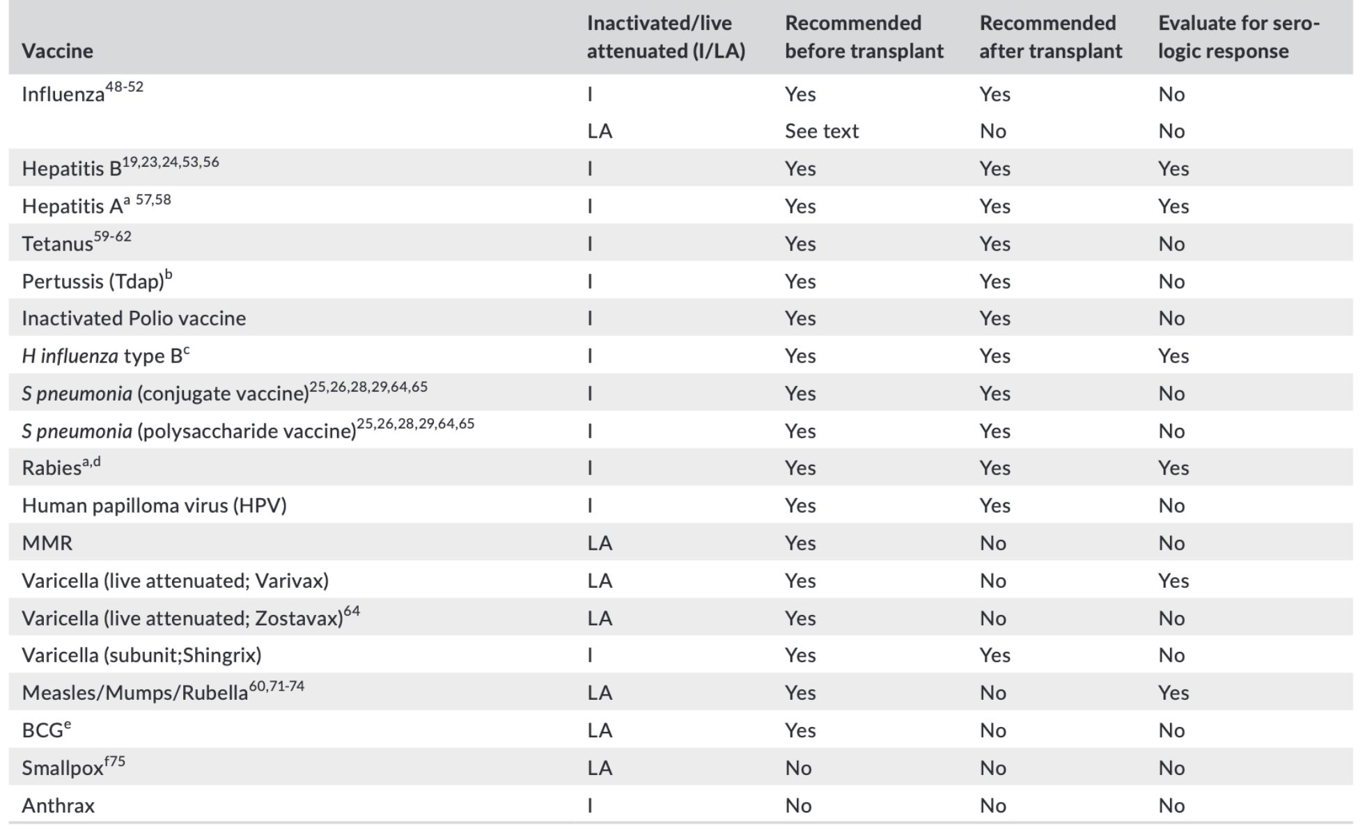
Pretransplant Vaccines
American Society of Transplantation (AST): Guidelines on vaccination of solid organ transplant candidates and recipients (2019)

Slide 29
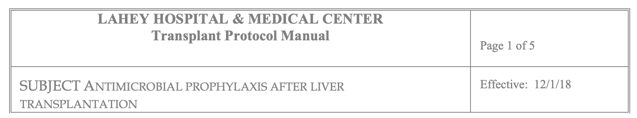
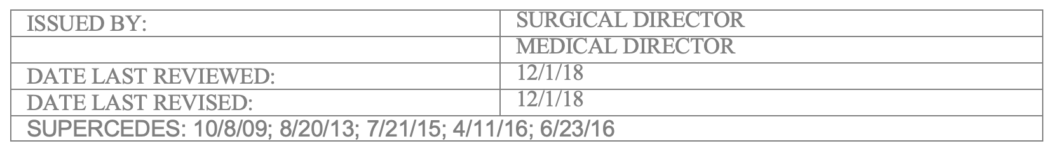
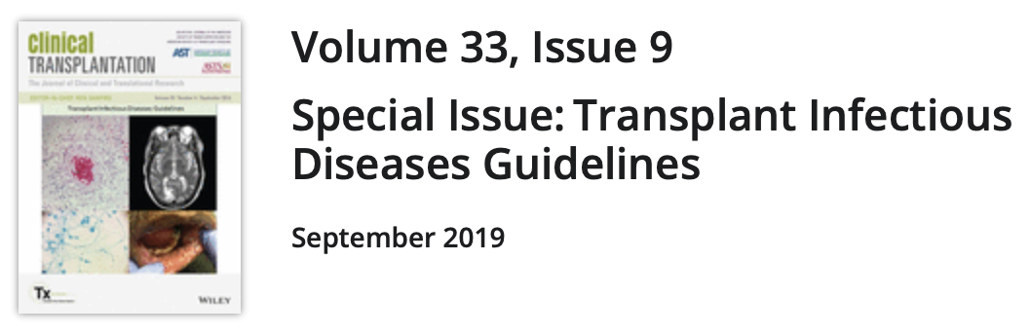
Lahey Liver Transplant Protocols

Slide 30
Antibacterial Prophylaxis

Slide 31
Antibacterial Prophylaxis
Surgical site infections are more common in liver transplant recipients compared to other solid organ transplants
  Rates are 10-37% in one report
No consensus exists for the management of patients colonized with resistant gram-negative organisms during the peritransplant period.
Universal decolonization with chlorhexidine (CHG) bathing is recommended for ICU patients to prevent transmission of MRSA (strong, high).
Diagn Microbiol Infect Dis. 2021;99(1):115220; Clin Transplant. 2019 Sep;33(9):e13611

Slide 32
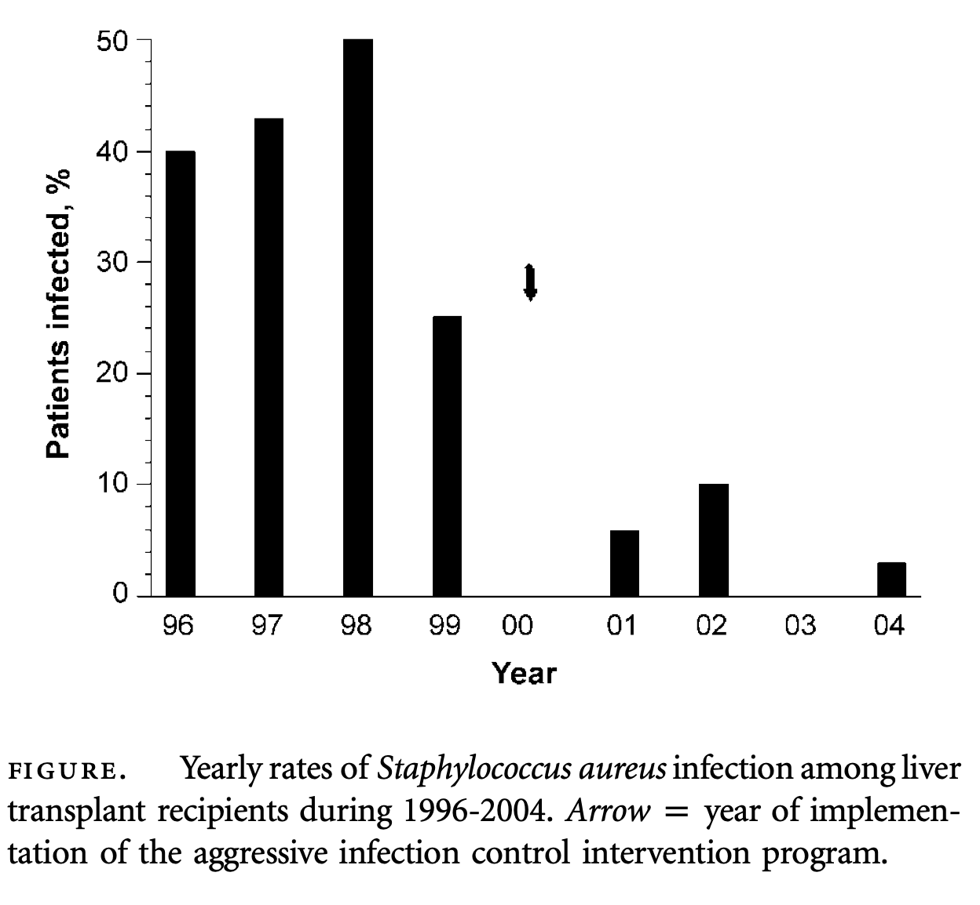
Impact of an aggressive infection control strategy on endemic Staphylococcus aureus infection in liver transplant recipients
Infect Control Hosp Epidemiol. 2006 Feb;27(2):122-6.

Slide 33
Antifungal Prophylaxis

Slide 34
Antifungal Prophylaxis (Candida mainly)
Targeted prophylaxis should be given to all adult liver transplant recipients at high risk for development of invasive candidiasis
Risk factors include (AST 2019 Guidelines)
  Retransplant or reoperation
  Renal failure -> RRT
  > 40 units of blood products
  Choledochojejunostomy
  Candida colonization perioperatively
Other risk factors
  MELD score ≥30
  Biliary leaks
  Living donor liver transplantation
Clin Transplant. 2019 Sep;33(9):e13623

Slide 35
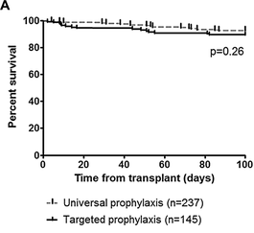
Targeted Versus Universal Antifungal Prophylaxis Among Liver Transplant Recipients
Am J Transplant. 2015 Jan;15(1):180-9

Slide 36
Antifungal Prophylaxis
As shown, along multiple other studies, the following is a is an effective and safe strategy:
Targeted prophylaxis in high-risk liver transplant patients
No fungal prophylaxis in low-risk patients
How about agent of choice?

Slide 37
Antifungal Prophylaxis
Fluconazole, voriconazole, echinocandins (micafungin), and low-dose amphotericin B have all been studied
All the above agents are safe and effective in multiple clinical trials
Echinocandins or AmphoB reserved if there are high incidence of non-albicans Candida
Duration of up to 2-4 weeks after transplant
AST 2019 Recommendations:
Fluconazole should remain the preferred antifungal choice for prophylaxis in high-risk LT recipients
Non-absorbable agents such as nystatin, clotrimazole, and enteral amphotericin B… not recommended
Clin Transplant. 2019 Sep;33(9):e13623

Slide 38
Aspergillus Prophylaxis
AST 2019 Guidelines
Targeted prophylaxis in patients with any of the following high-risk factors is recommended
  Retransplant or reoperation (same for candida)
  RRT (HD or CVVH) within 7 days of Txp (same for candida!)
Agents: Anidulafungin, micafungin or caspofungin in standard dose, or voriconazole
Duration: 2-3 weeks
Clin Transplant. 2019 Sep;33(9):e13544

Slide 39
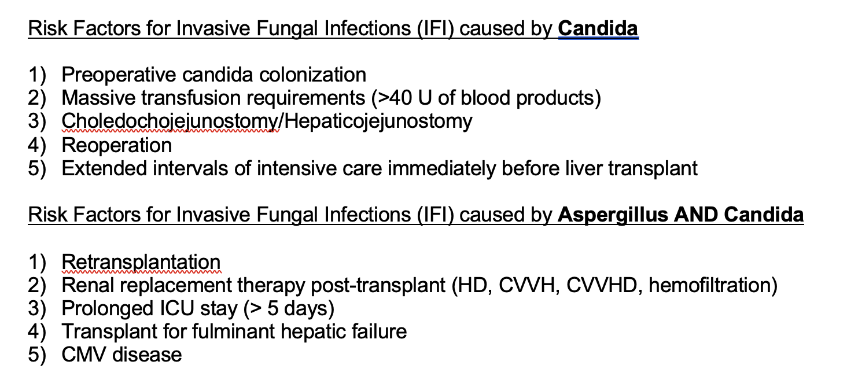
Lahey Protocol

Slide 40
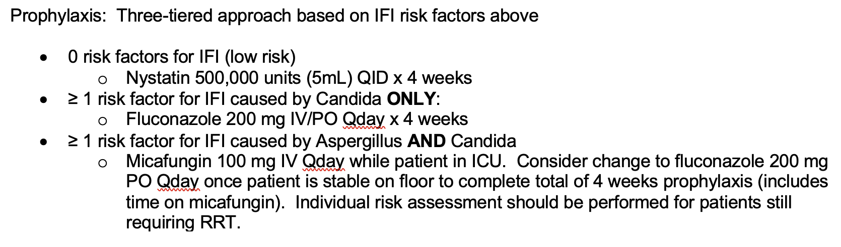
Lahey Protocol

Slide 41
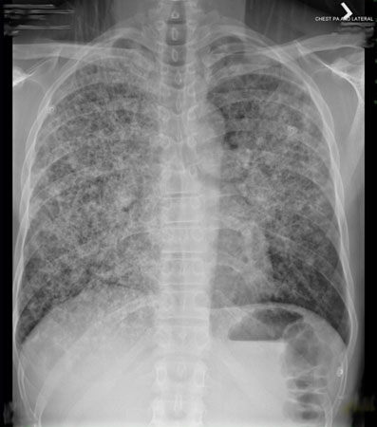

Slide 42
Pneumocystis jirovecii Prophylaxis
Pneumocystis jirovecii is a ubiquitous and common fungus
It can cause pneumocystis pneumonia (PCP) in immunocompromised hosts
Incidence used to be 10-15% of all transplant patients
  (up to 80% in lung txp)
Virtually eradicated in the era of antimicrobial prophylaxis
Prophylaxis is recommended in all post liver transplant patients
Duration of therapy (AST 2019 guidelines)
  6-12 months after transplant
  Some experts call for lifelong in post liver transplant patients
Clin Transplant. 2019 Sep;33(9):e13623

Slide 43
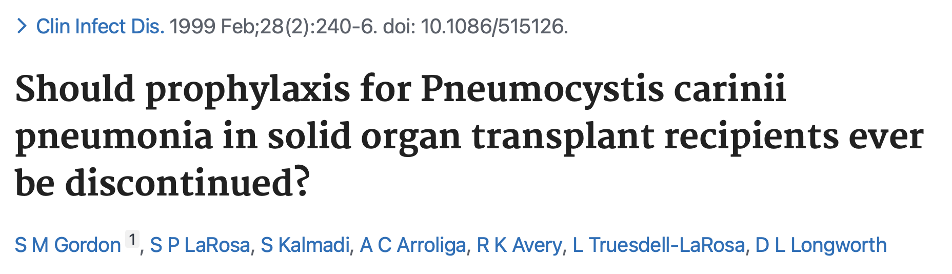
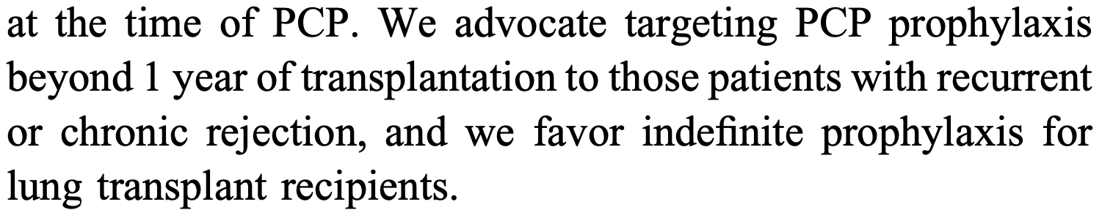

Slide 44
Pneumocystis jirovecii Prophylaxis
First choice: trimethoprim-sulfamethoxazole (Bactrim)
  Bone marrow suppression
  Rash -----> Steven Johnson
  Inhibits potassium and creatinine secretion
    HyperK and hyperCreatininemia -> “pseudo AKI”
    Synergistic effect with cyclosporine
Second line agents
  Dapsone: avoid in G6PD deficiency
  Atovaquone
  Pentamidine (inhaled)
  Clindamycin + pyrimethamine
History of "allergy" to TMP-SMX may be misleading, and allergy testing is often worthwhile.
Clin Transplant. 2019 Sep;33(9):e13587

Slide 45
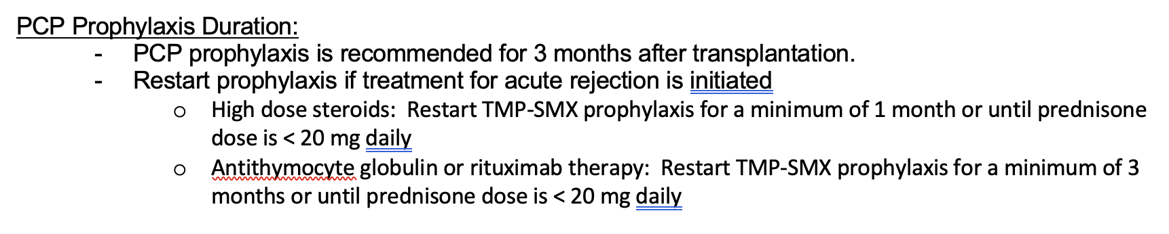
Lahey Protocol

Slide 46
Cytomegalovirus (CMV) Prophylaxis
Human Herpesvirus 5

Slide 47
CMV Prophylaxis
CMV is the most important viral infection in post liver transplant patients
CMV infection refers to virus isolation or detection of viral proteins (antigens) or nucleic acid in any body fluid or tissue specimen regardless of symptoms or signs.
CMV disease refers to evidence of CMV infection with attributable symptoms or signs
  CMV disease may manifest as either a viral syndrome (eg, fever, malaise, leukopenia, neutropenia, atypical lymphocytosis, thrombocytopenia) or as tissue-invasive disease.

Slide 48
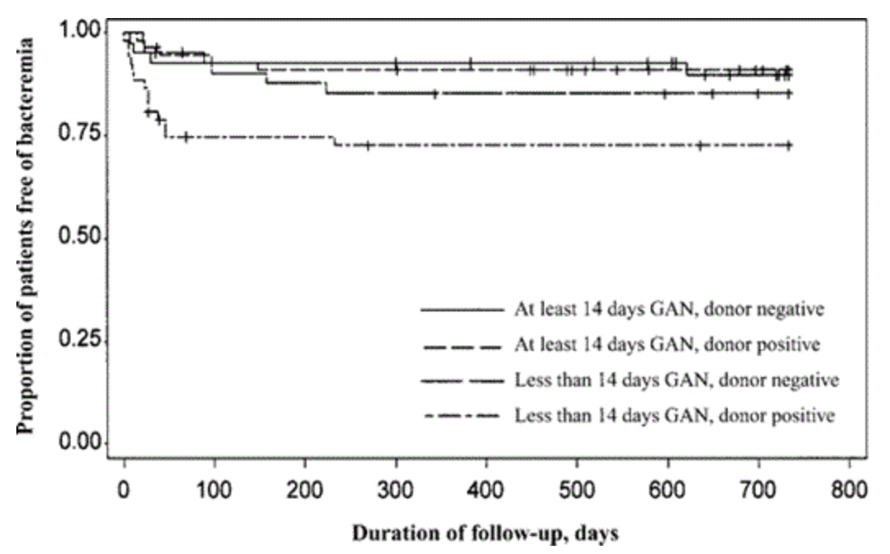
CMV Post Liver Transplant
The risk of CMV infection and disease depends on pre-transplant donor (D) and recipient (R) statuses of CMV
  D+/R- have the highest risk
  D*/R+ have modest risk
  D-/R- have the lowest risk
CMV has some immune-related implications
  Increases risk of bacteremia
  Increases risk of invasive fungal infections
  Increases one-year mortality
The clinical impact of ganciclovir prophylaxis on the occurrence of bacteremia in orthotopic liver transplant recipients
Clin Infect Dis 2004 Nov 1;39(9):1293-9

Slide 49
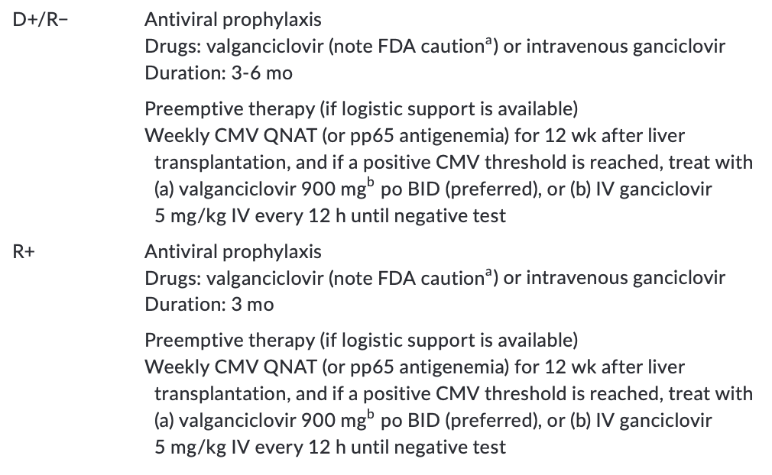
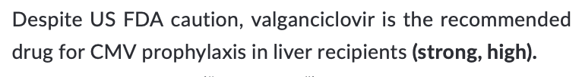
CMV Prophylaxis
ªThe US FDA has cautioned against valganciclovir prophylaxis in liver recipients due to high rate of tissue‐invasive disease compared to oral ganciclovir.
AST 2019 Guidelines

Slide 50
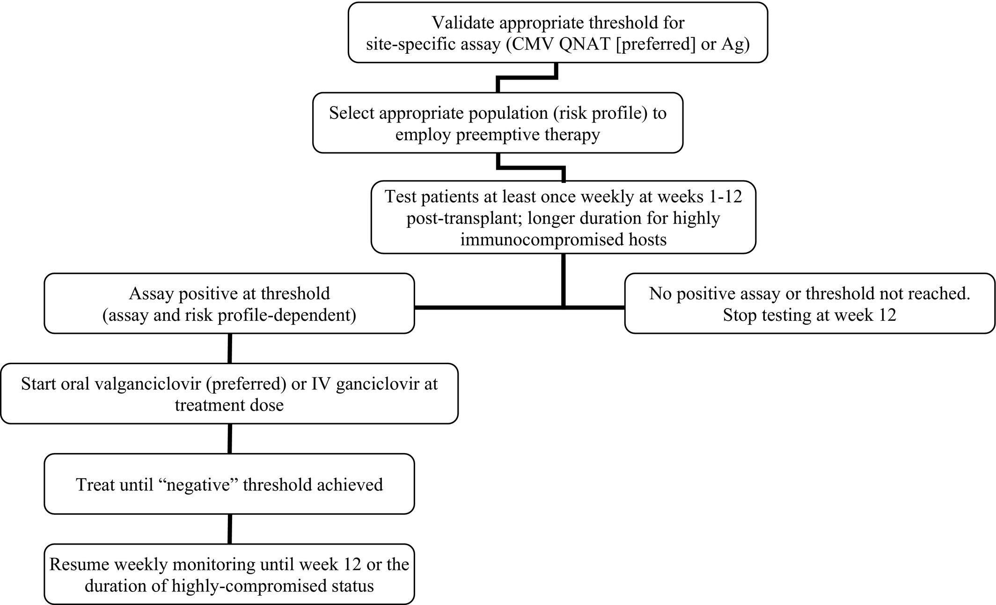
CMV Preemptive Treatment
Clin Transplant. 2019 Sep;33(9):e13512

Slide 51
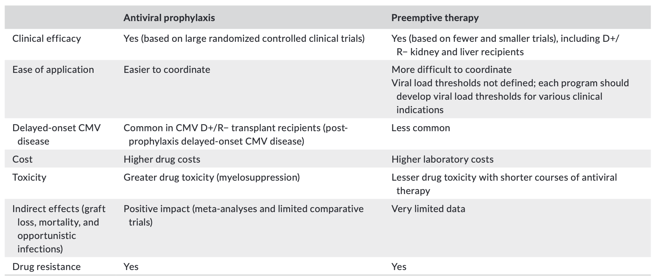
Universal Prophylaxis – give anti-CMV for highest risk
Preemptive Therapy – give anti-CMV only when viremic
Clin Transplant. 2019 Sep;33(9):e13623

Slide 52
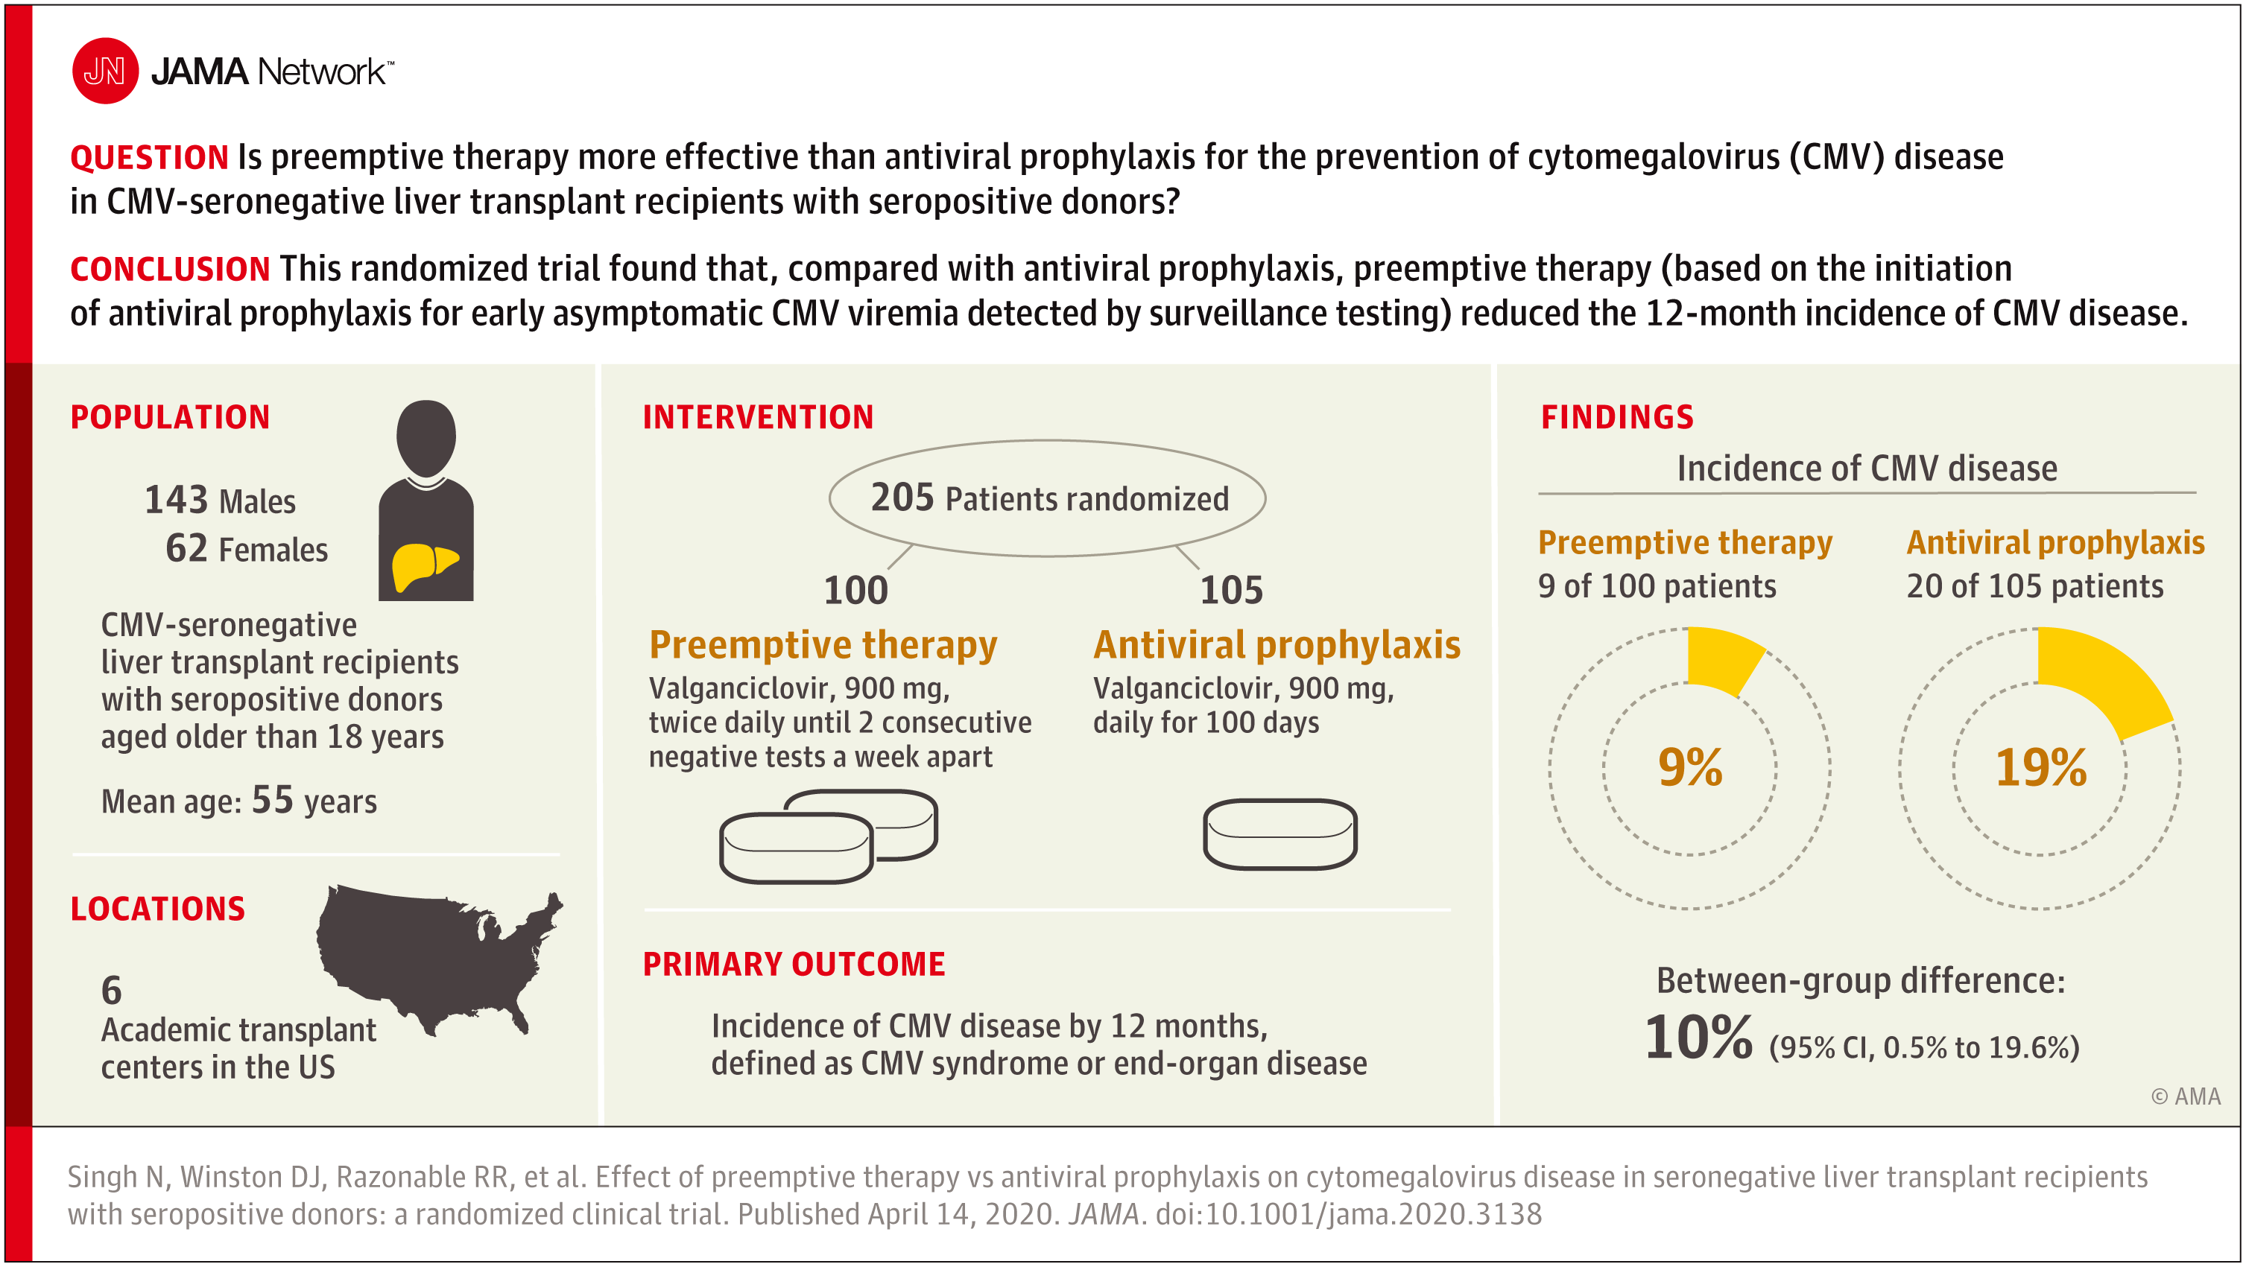

Slide 53
Late-onset CMV
The term “postprophylaxis delayed-onset CMV disease” may distinguish this entity from the truly late-onset CMV diseases that occur many years after transplantation.
What can be done?
Clinical close follow up of high-risk patients (D+/R-) after completing prophylaxis
OR
CMV QNAT at least once weekly for 3 months after completion of antiviral prophylaxis

Slide 54
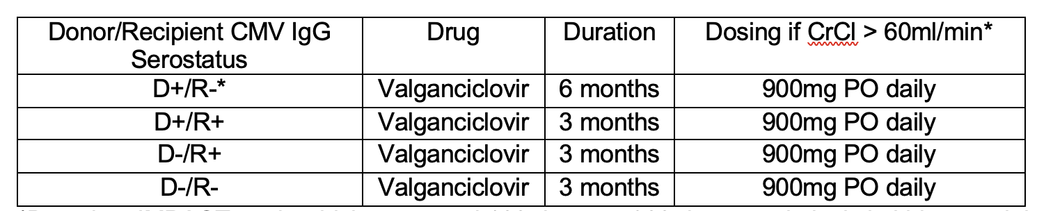
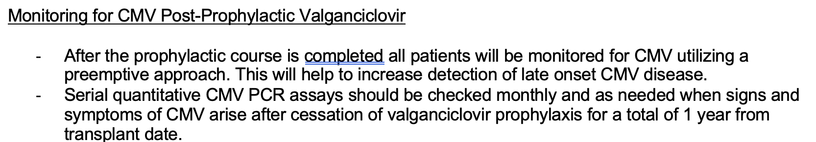
Lahey Protocol
Ongoing Quality Improvement project to increase and ease the adherence to this protocol!

Slide 55
Time Course of Post Transplant Infections

Slide 56
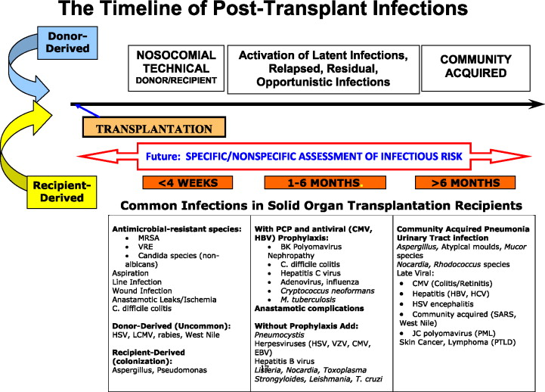
Fishman JA. N Engl J Med 2007;357:2601-2614.
Notes:
Figure 4. Changing Timeline of Infection after Organ Transplantation. Infections occur in a generally predictable pattern after solid-organ transplantation. The development of infection is delayed by prophylaxis and accelerated by intensified immunosuppression, drug toxic effects that may cause leukopenia, or immunomodulatory viral infections such as infection with cytomegalovirus (CMV), hepatitis C virus (HCV), or Epstein–Barr virus (EBV). At the time of transplantation, a patient's short-term and long-term risk of infection can be stratified according to donor and recipient screening, the technical outcome of surgery, and the intensity of immunosuppression required to prevent graft rejection. Subsequently, an ongoing assessment of the risk of infection is used to adjust both prophylaxis and immunosuppressive therapy. MRSA denotes methicillin-resistant Staphylococcus aureus, VRE vancomycin-resistant Enterococcus faecalis, HSV herpes simplex virus, LCMV lymphocytic choriomeningitis virus, HIV human immunodeficiency virus, PCP Pneumocystis carinii pneumonia, HBV hepatitis B virus, VZV varicella–zoster virus, SARS severe acute respiratory syndrome, PML progressive multifocal leukoencephalopathy, and PTLD post-transplantation lymphoproliferative disorder. Modified from Fishman and Rubin ¹ and Rubin et al. ⁴⁵

Slide 57
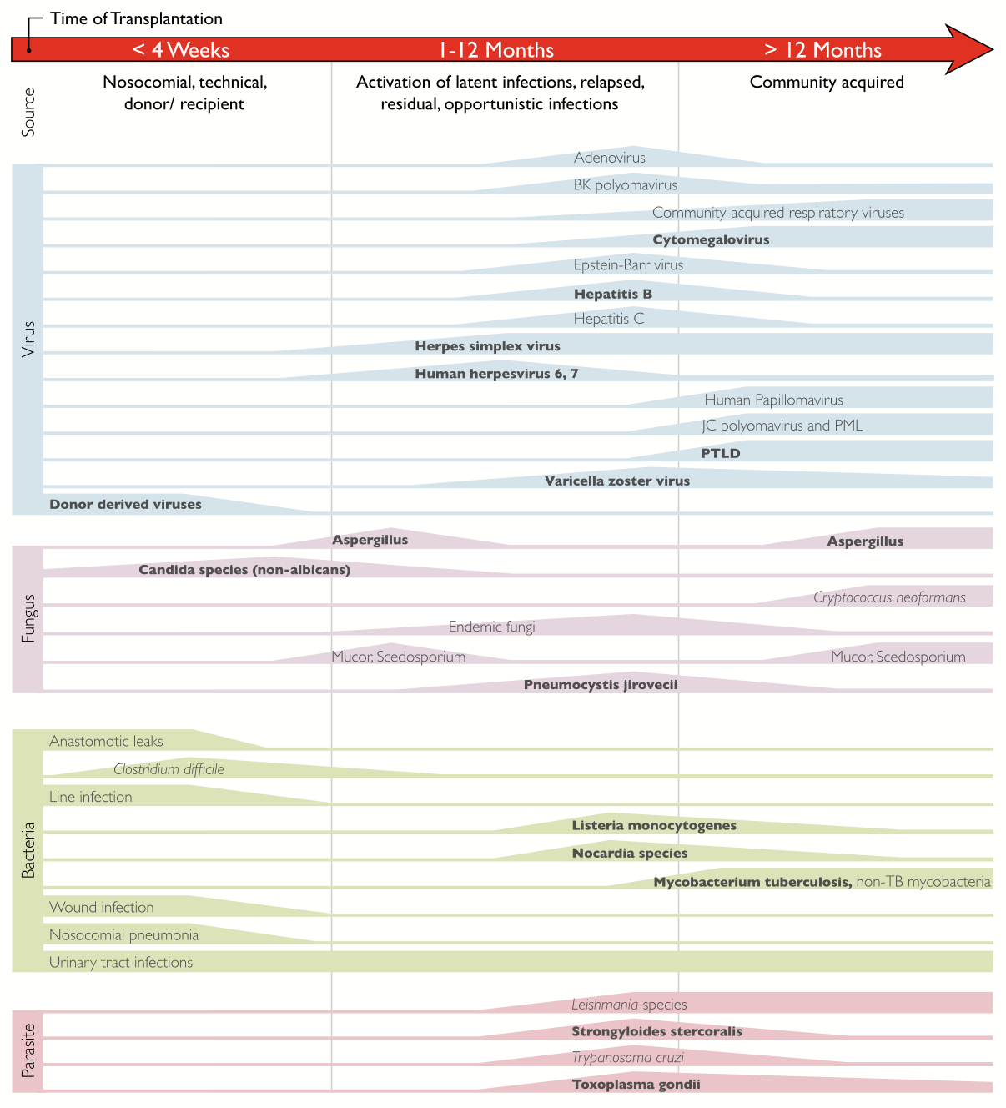
Am J Transplant. 2017 Apr;17(4):856-879

Slide 58
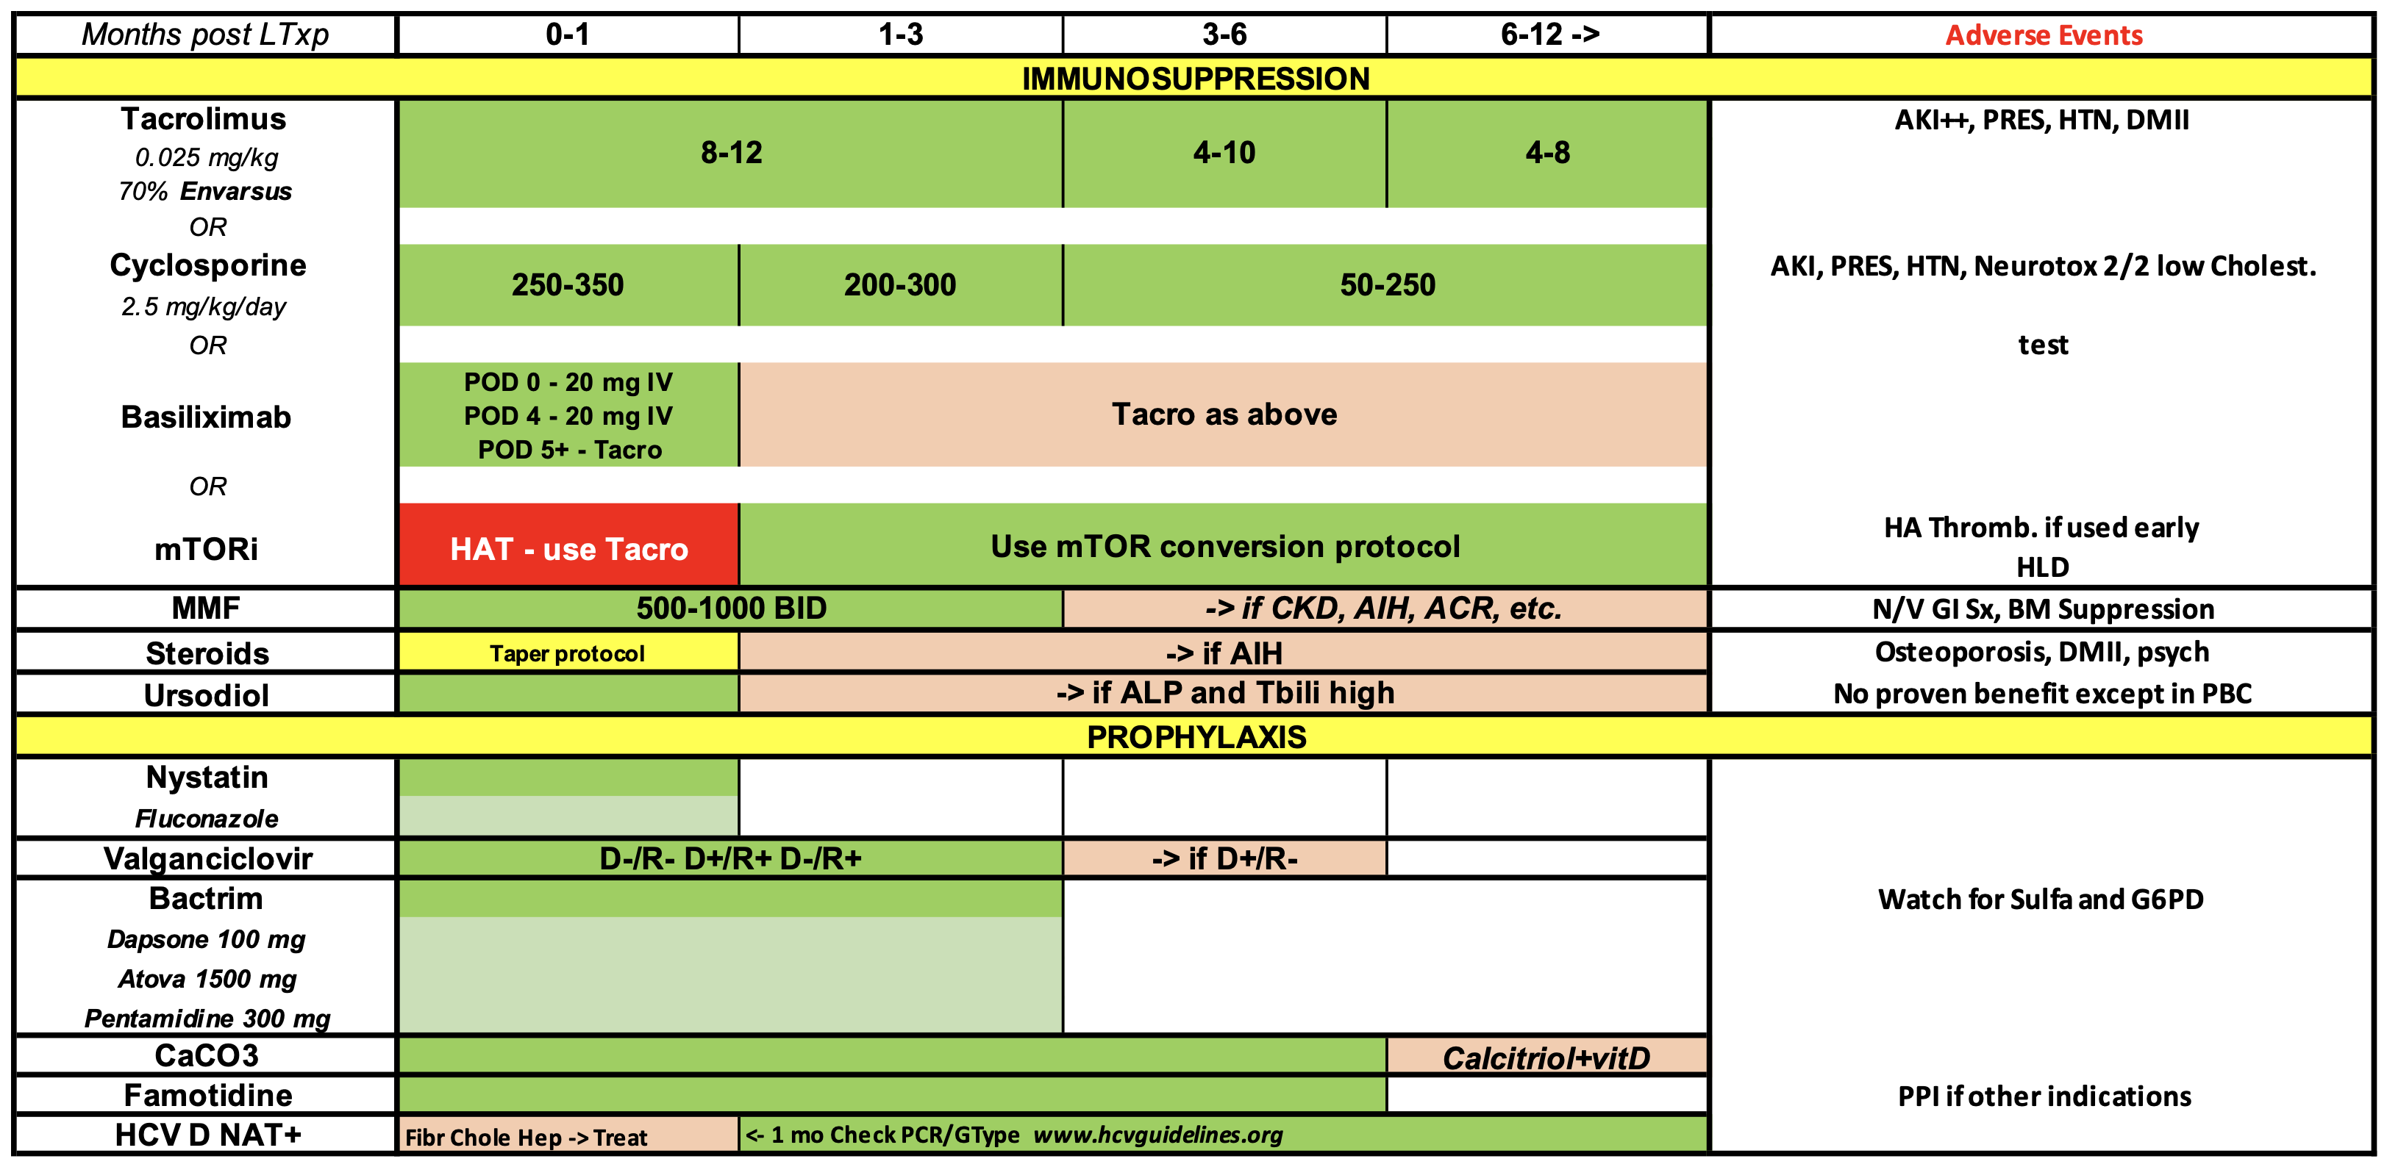

Slide 59
Take-home Points
Post liver transplant infections are a major source of M&M
Immunosuppression is T cell suppression
Vaccinate and decolonize MRSA
Prophylaxis
  Antibacterials -> Case by case
  Antifungals -> Nystatin, fluconazole, micafungin
  Anti-PCP -> Bactrim, others
  Anti-CMV -> Valganciclovir
Watch for late CMV!
  always a good answer to “I don’t know what’s happening with this post LTx patient”
Timing of infection varies

Slide 60
Thank You
Questions

